Slide 1
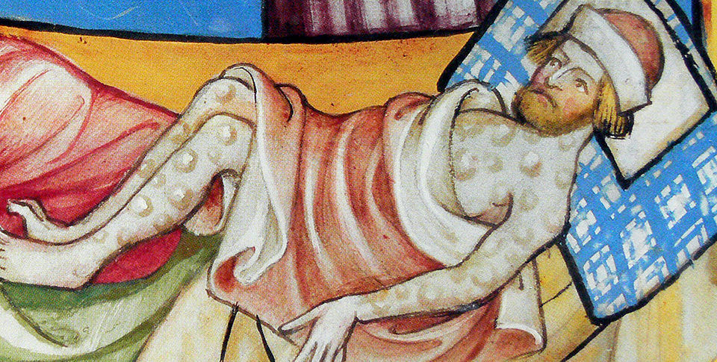
Medieval Christian Europe (330–1450)
Topic 1 Lesson 7 The Late Middle Ages: A Time of Upheaval

Slide 2
Medieval Christian Europe (330–1450)
Topic 1 Lesson 7 The Late Middle Ages: A Time of Upheaval
Learning Objectives
Understand how the Black Death caused social and economic decline.
Describe the problems facing the Church in the late Middle Ages and how the Church reacted.
Summarize the causes, turning points, and effects of the Hundred Years' War.

Slide 3
The Black Death Spreads Across Europe
A Global Epidemic
A strain of the plague comes from the Mongols. It starts in China and as trade caravans head east the plague is in the caravans
The Arrival
In 1347 Genoese ships coming from Caffa land in Messina, Sicily. These ships bring the plague
One in 3 people die
Social Upheaval
With no way to stop the disease people turned to magic, witchcraft, self flagellation, hiding from the disease.
They will also blame the Jews and kill thousands

Slide 4
The Black Death Spreads Across Europe
Economic Impact
With so many deaths production will decline and survivors will demand higher wages
This leads to higher prices for goods
Eventually higher wages will lead to market economies and the end of the medieval order
Nobles are going to lose out because of the rise of wages with the loss of peasantry will make them lose money
Monarchies are going to get stronger because they are going to be able to tax merchants in the cities who survived.

Slide 5
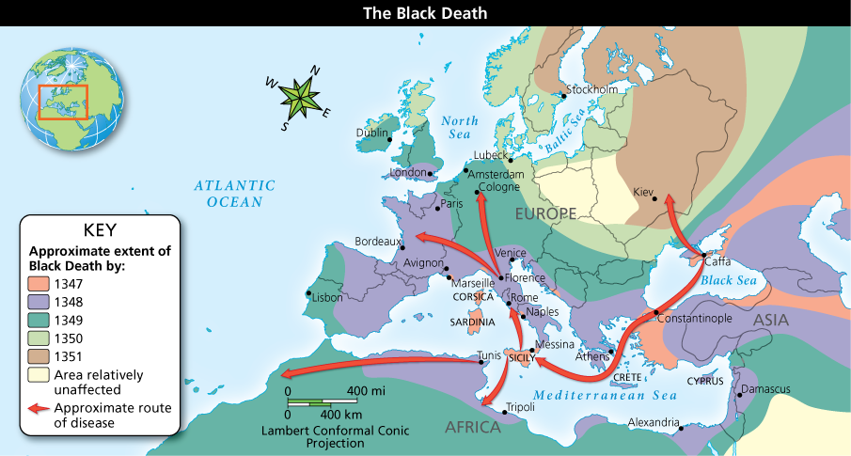
The Black Death Spreads Across Europe
The Black Death spread so quickly and was so deadly that entire villages were wiped out. Analyze Maps Where did the plague originate, and why do you think the plague reached certain areas more quickly than others?

Slide 6
The Black Death Spreads Across Europe
This medieval illustration shows a man dying of the plague. Boils erupting all over the body was a sign that the plague would likely claim more victims because the disease spread through contact.

Slide 7
Crisis in the Church
Divisions in the Church
In 1309 Pope Clement V moves the Papal Court from Rome to Avignon.
In 1378 reformers in the Church chose a Pope in Rome. French cardinals will elect their own Pope
There will be 2 or 3 Popes at the same time, creating a Schism
This will weaken its moral authority
New Heresies Threaten the Church
John Wycliffe will attack corruption of the Church in England
Wycliffe insists that the Bible is the source of all Christian truth
His ideas will be taking to Bohemia and Jan Hus will call for reform
Wycliffe and his followers will be persecuted
Jan Hus will be found guilty of heresy and burned at the stake
Their ideas will carry on to other reformers who will eventually split the Catholic Church

Slide 8
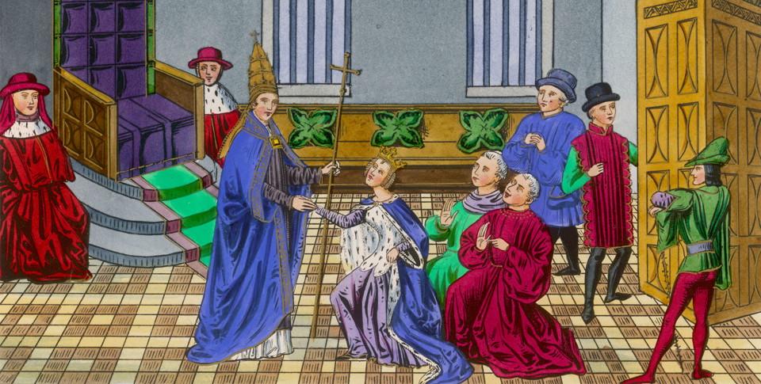
Crisis in the Church
Pope Clement V receives a noblewoman at the papal court in Avignon. Papal wealth would bring later trouble to the Church.

Slide 9
The Hundred Years’ War
Rival Powers: England and France
Edward III of England is going to claim the French crown in 1337
Economic rivalry and national pride is going to make them continue fighting
Early Victories for England
England is going to be in control at first because of the longbow
Just when it looks like England is going to win the war a miracle happens
Joan of Arc
In 1429 Joan is going to meet with the French King Charles VII
She convinces him to let her lead his armies
In one year she leads the French to several victories
The English will capture her and burn her at the stake for witchcraft. Later she will be declared a saint

Slide 10
The Hundred Years’ War
Results of the Long War
The French will use cannons to recover their lost lands leaving Calais as the only English territory in France
The French King will expand his power with this feeling of national pride
The English Parliament will gain more power through the power of the purse as the king needed more funds for the war
English rulers will turn to overseas trade
Change and Recovery
Longbow and cannons are going to make knights obsolete
Monarchs are going to need armies, not vassals to fight wars
Recovery from the Black Plague will lead to trade, new technology development
All of these things will lead to the Renaissance, The Reformation, and the Age of Exploration

Slide 11
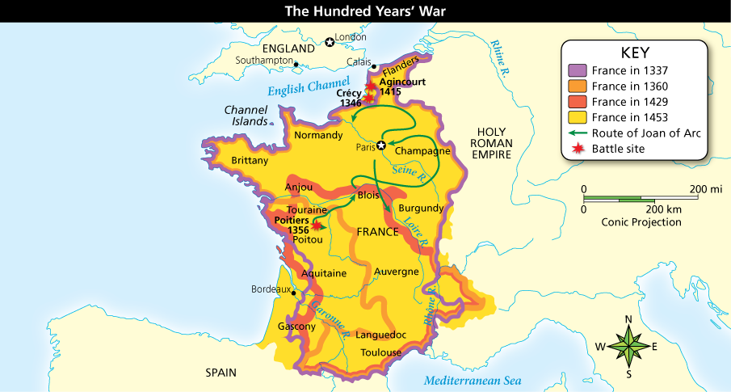
The Hundred Years’ War
The English and French battled for control of France. Analyze Maps What regions of France did England gain between 1337 and 1429?

Slide 12
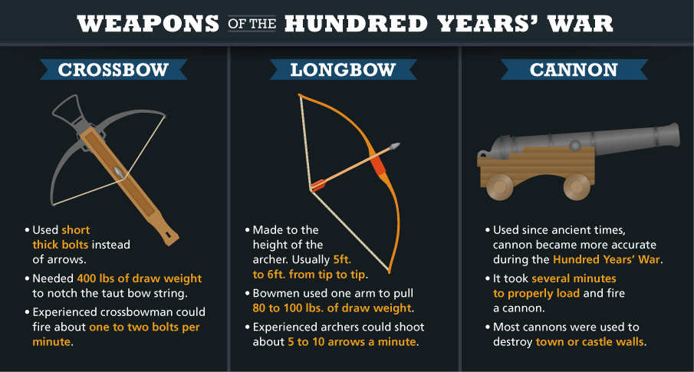
The Hundred Years’ War
During the Hundred Years' War, weapons technology and mastery greatly influenced the outcome of specific battles. Analyze Charts Why might the longbow have been a more valuable weapon in war?

